Slide 1
INTRODUCTION TO WEB DEVELOPMENT - SESSION 4
Stojancho Jefremov - stojanco.jefremov@gmail.com

Slide 2

AGENDA FOR TODAY
The process of problem solving
Phases of making a program(software)
Solving tasks (Exercises)
Logical operators
@SEDC 2018-2019

Slide 3

Problem solving is a process
@SEDC 2018-2019

Slide 4

THE PROCESS OF PROBLEM SOLVING
Understanding the problem
Devising a plan
Execution of the plan
Looking back
@SEDC 2018-2019

Slide 5
UNDERSTANDING THE PROBLEM
What is the unknown?
What is the data?
What is the condition? Is it possible to satisfy the condition?
Is the condition sufficient to determine the unknown?
Draw a diagram. Introduce suitable notation.
@SEDC 2018-2019

Slide 6
DEVISING A PLAN
Have you seen the problem before? Do you know a related problem?
Look at the unknown. Think of a problem having the same or similar unknown.
Split the problem into smaller sub-problems.
If you can’t solve it, solve a more general version, or a special case, or part of it
@SEDC 2018-2019

Slide 7
EXECUTION OF THE PLAN
Carry out your plan of the solution. Check each step.
Can you see clearly that the step is correct?
Can you prove that it is correct?
@SEDC 2018-2019

Slide 8
EXECUTION OF THE PLAN
Can you check the result?
Can you derive the result differently?
Can you use the result, or the method, for some other problem?
@SEDC 2018-2019

Slide 9
What about phases of making a program?
@SEDC 2018-2019

Slide 10
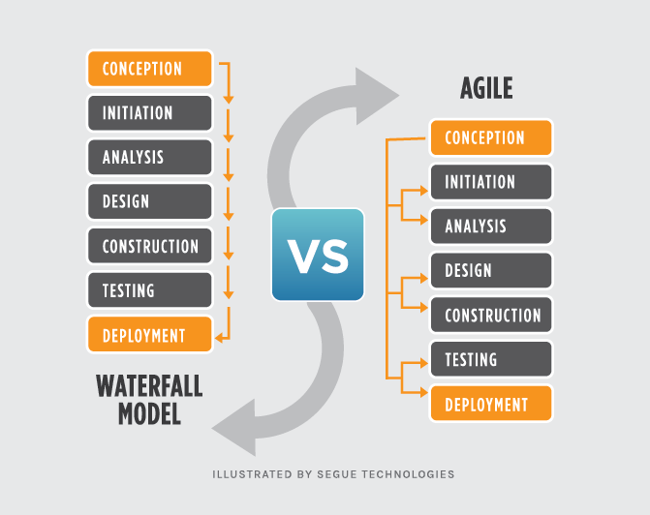
PHASES OF MAKING A PROGRAM(SOFTWARE)
@SEDC 2018-2019

Slide 11
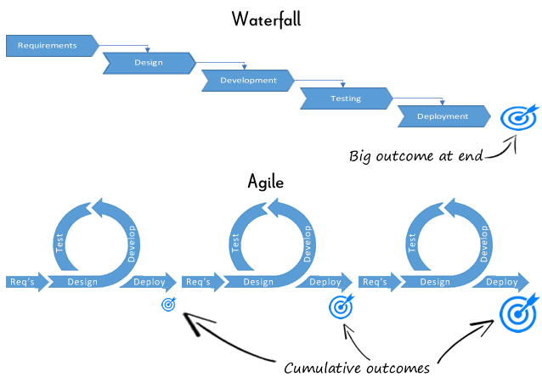
PHASES OF MAKING A PROGRAM(SOFTWARE)
@SEDC 2018-2019

Slide 12
TASK I
Write a simple program that makes a Miles in Kilometers conversion
1Km = 1.60934Miles
Time to complete? (Estimate :))
@SEDC 2018-2019

Slide 13
TASK II
Write an algorithm for finding the greates number out of three without using nested if statements.
Hint: Ask questions!
Time to complete? (Estimate :))
@SEDC 2018-2019

Slide 14
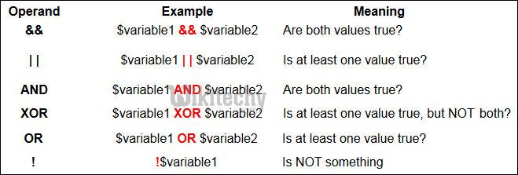
LOGICAL OPERATORS

Slide 15
TASK III
Write a program that finds a specific name of student out of a collection of students
Hint: Ask questions!
Time to complete? (Estimate :))
@SEDC 2018-2019

Slide 16
TASK IV
Write out a program that for a given number determines if it is prime or not.
Hint: Ask questions!
Time to complete? (Estimate :))
@SEDC 2018-2019

Slide 17

Time for questions!
@SEDC 2018-2019

